Slide 1
Data Mining Project Proposal
Group Doreamon:
Abdul Gafar Manuel Meque
Chih-Ming Chen
Sachit Mahajan

Slide 2
Problem Description
What Knowledge?
Given a Post p with upvotes u and downvotes d
Can we predict the opinion polarity (negative | positive) based on u & d?
P(p=negative|u,d)
P(p=positive|u,d)
Can we Predict the u,d distribution based on p?
P(u,d|p)
The relationship between post emotion/polarity and its words under different subreddit.

Slide 3
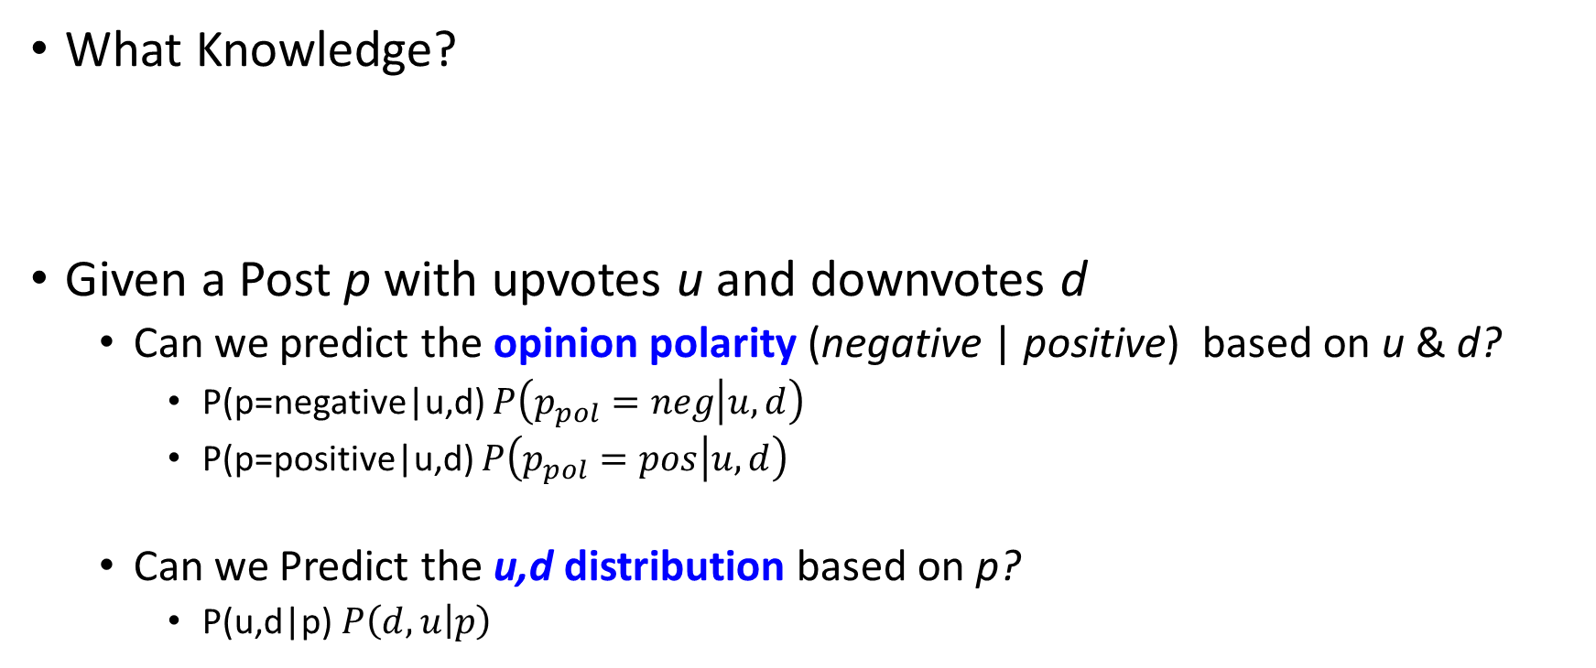
Problem Description
What Knowledge?
Given a Post p with upvotes u and downvotes d
Can we predict the opinion polarity (negative | positive) based on u & d?
P(p=negative|u,d) $P\left(p_{pol}=neg | u,d\right)$
P(p=positive|u,d) $P\left(p_{pol}=pos | u,d\right)$
Can we Predict the u,d distribution based on p?
P(u,d|p) $P\left(d,u | p\right)$
The relationship between a word and its polarity under different subreddit.

Slide 4
Work flow
Reddit
Dataset
Data Cleaning e.g. removing stop words

Slide 5
Work flow
Train
Data
80%
Reddit
Dataset
Data Cleaning e.g. removing stop words
Test
Data
20%

Slide 6
Work flow
Extracted features:
1. Vector Space Model
2. Latent Topic Model
Feature
Extraction (Methodology)
Train
Data
Feature Set
80%
Reddit
Dataset
Data Cleaning e.g. removing stop words
Test
Data
20%

Slide 7
Work flow
Extracted features:
1. Vector Space Model
2. Latent Topic Model
Feature
Extraction (Methodology)
Train
Data
Feature Set
80%
Reddit
Dataset
Data Cleaning e.g. removing stop words
Test
Data
20%
Assistant
Resources
Opinion
Lexicon
Emotion
Lexicon
…
WordNet
Python NLTK

Slide 8
Work flow
Extracted features:
1. Vector Space Model
2. Latent Topic Model
Feature
Extraction (Methodology)
Train
Data
Feature Set
80%
Reddit
Dataset
Data Cleaning e.g. removing stop words
Statistics
Test
Data
20%
Data Analysis,
Feature Analysis
Viaualization
Assistant
Resources
Data Visualization:
1. Histogram
2. Word Cloud
3. Clustering
Opinion
Lexicon
Emotion
Lexicon
…
WordNet
Python NLTK

Slide 9
Work flow
Extracted features:
1. Vector Space Model
2. Latent Topic Model
Feature
Extraction (Methodology)
Train
Data
Feature Set
80%
Reddit
Dataset
Data Cleaning e.g. removing stop words
Classifier
Statistics
Test
Data
20%
Data Analysis,
Feature Analysis
Viaualization
Assistant
Resources
Predictions
Data Visualization:
1. Histogram
2. Word Cloud
3. Clustering
Opinion
Lexicon
Emotion
Lexicon
…
WordNet
Python NLTK
Algorithm Comparison,
Performance Evaluation
Accuracy

Slide 10
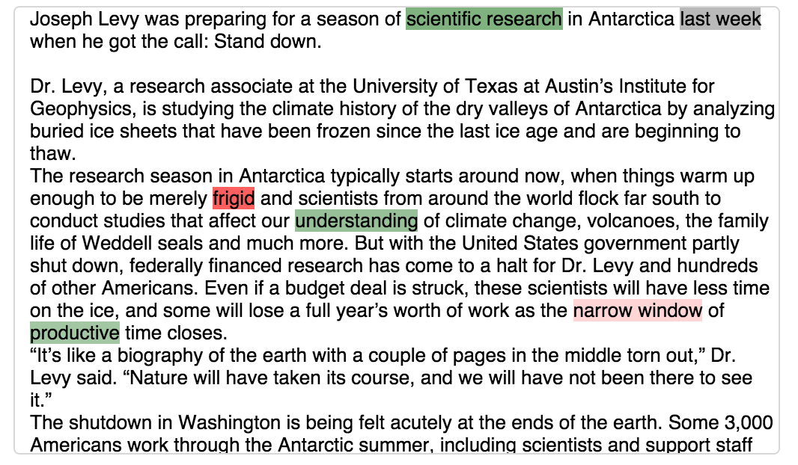
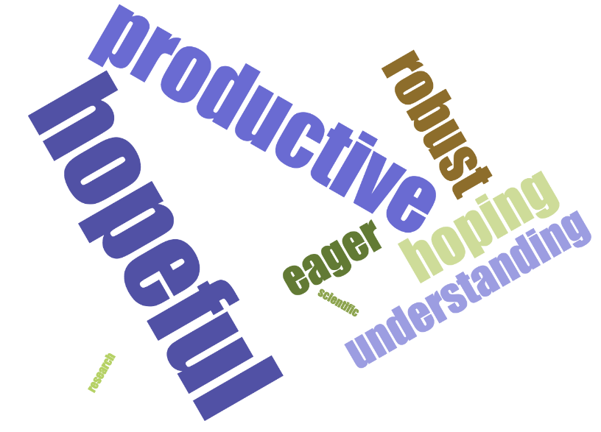
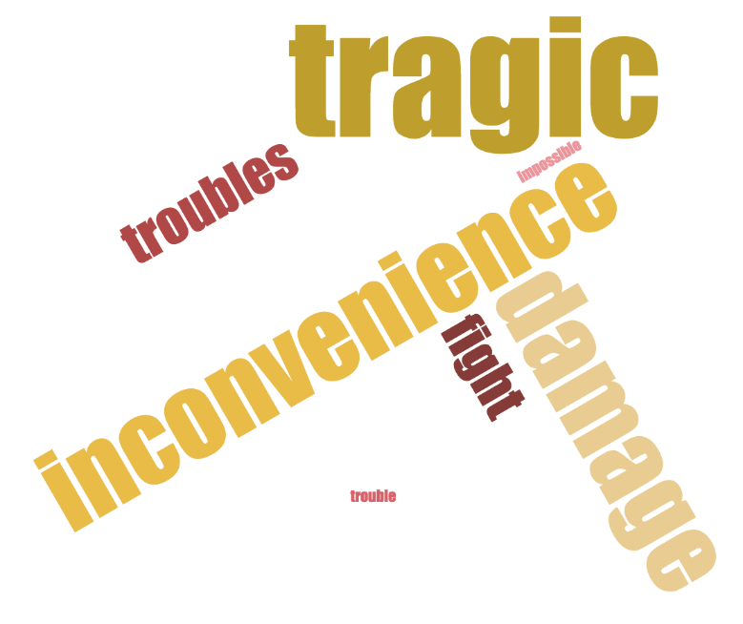
A Sketch
In a subreddit, given a post
Upvotes: 10
Downvotes: 1
Positive? Negative?
Neutral?

